Slide 1
ZERIX TEXT IS A TEXT MESSAGING SYSTEM
Effective Business Communication
Keep your customers engaged
is critical to your company’s growth and success

Slide 2
Make Decisions Faster
User Friendly and Easy to Install
Efficient transfer of important information via SMS/text messages.
Instant Response to your Queries
Get real-time information.
It works like an auto-responder.
View Customized Reports on your PC
Monitor your text correspondence using ZERIX to attend to all your customer’s and staff queries.

Slide 3
Sample Use Cases
Info-on Demand Using Keywords
Sales and Inventory figures
Frequently Asked Questions
HR Reminders to Staff
Staff Attendance Notification
Leave Credits & Benefits Inquiry
Data Collection
Form-based with customized input fields
Surveys and Feedback

Slide 4
Sample Use Cases
Product Orders via SMS/Text
Monitor Text Orders
Delivery Notifications
Customer Inquiries and Feedback
Safety and Security Alerts
IT and Building Maintenance Support
Blast Text for Announcements & Marketing
News and Situational Alerts
Auto-Billing Reminders
Event Invitations and Registrations
Promos, Offers, Sales and Discounts

Slide 5
Key Features
Effortless and Intuitive
Collect Data
Text Blasts / Reminders
Info-On-Demand
Manage Queue
ZERIX Text will help you save time, cut costs effectively, and boost your organization’s productivity.
Message Wall
Import Contacts
Multi-User Access
Auto-Reply
Keyword Creation
Built-in Phonebook
Custom Reports Generator
Easy Database Integration
Remote Access
Polls & Voting
SMS API
Electronic Raffle

Slide 6
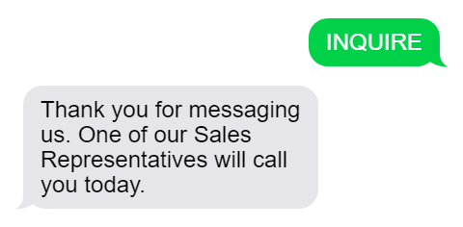
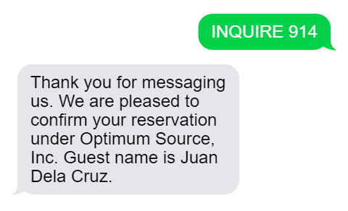
Automatic System Reply
Simple Message Reply
Intelligent Message Reply
Keyword Format:
Keyword Format:
INQUIRE
INQUIRE
Reservation_Number
Text from client
Text from client
ZerixText Auto-Reply
ZerixText Auto-Reply

Slide 7
Try Using Keywords
Zerixpromo
Zerix
Static Message
Kindly try texting this #
09672634790

Slide 8
Try Using Keywords
Zerixgetinfo ID
Zerixreg
firstname,lastname
Dynamic Message
Kindly try texting this #
09672634790

Slide 9
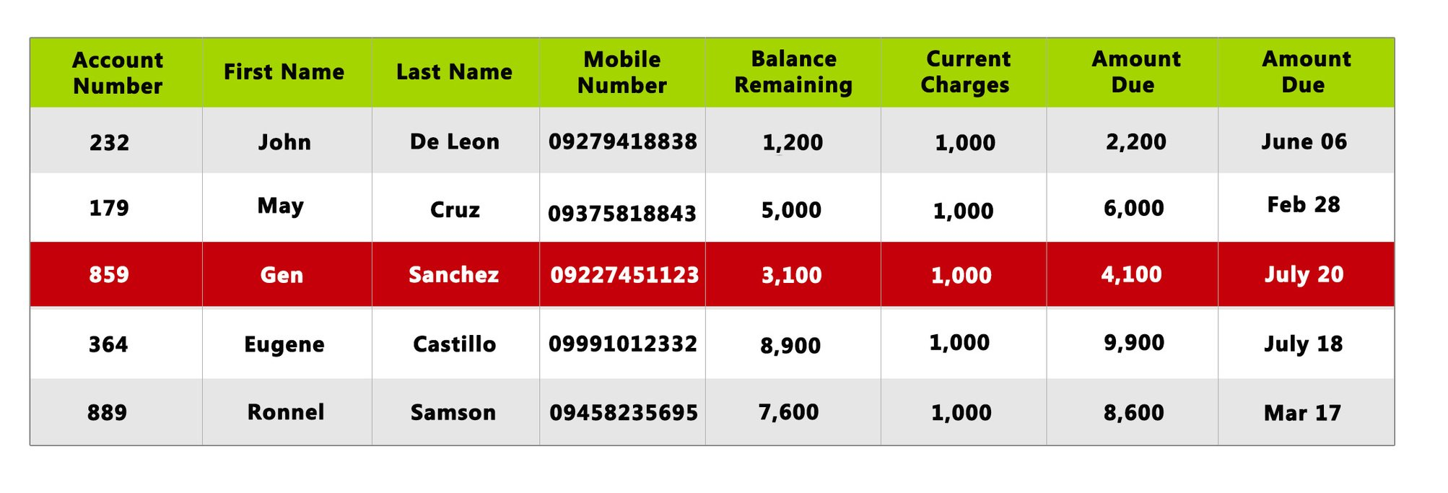
Sample Database
ZERIX can collect to any ODBC Compliant DB
such as MYSQL, MS SQL, ORACLE, etc.

Slide 10
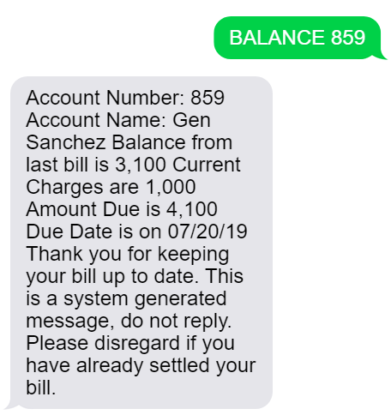
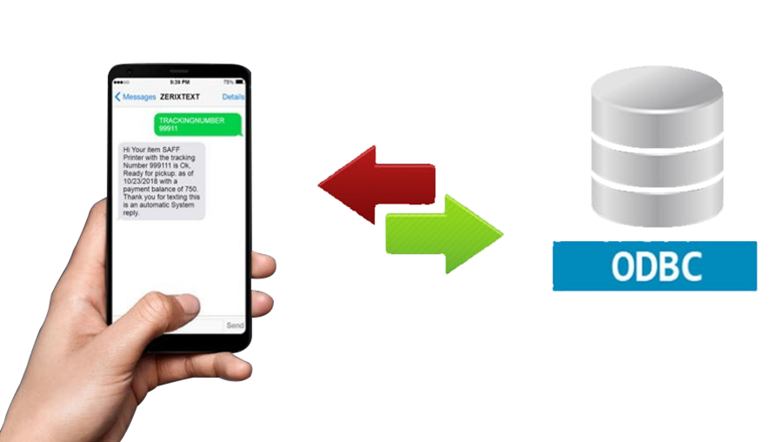
Text from client
Data Inquiry
Using Keywords, people can get important information from your database.
ZerixText Auto-Reply

Slide 11
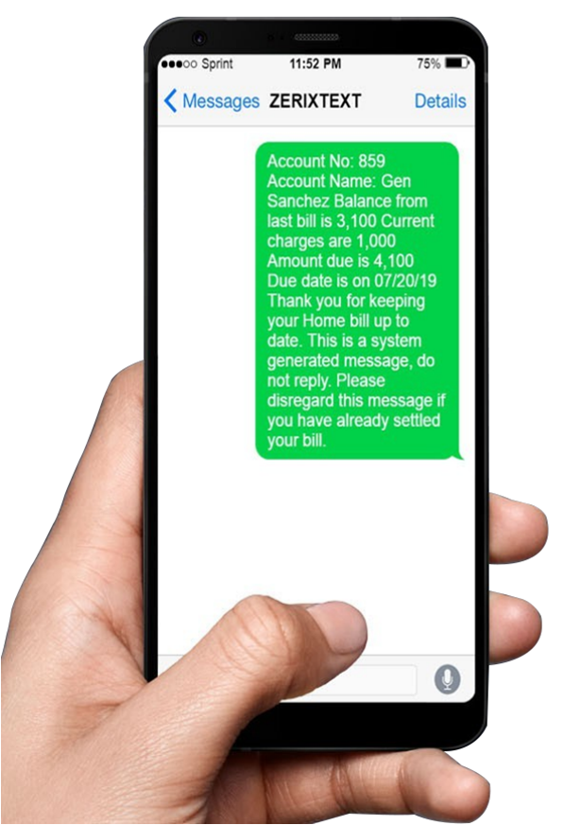
Auto-Billing Reminder
Sample Database
ZERIX automatically gets the data from your database and sends it to your client via SMS.

Slide 12
Collect Data
Anywhere, Anytime
Fully Automated Data Collection
Make Data Driven Business Decisions
Reduce Costs in gathering data
Data Collection Form Builder
Create simple and easy to fill out forms with customizable text fields
Reduce the labor of time-consuming input of keywords

Slide 13
Industry leaders use ZerixText

Slide 14
Industry leaders use ZerixText

Slide 15
Industry leaders use ZerixText

Slide 16
Struggling to manage business communications effectively?
Text messages have a 200% higher response rate than
email, instant messaging, chat apps, social media and chatbots.
ZERIX is valuable in delivering critical information with a high success rate
Please let us know how we can help.
THANK YOU.
The ZERIX Team
reachus@zerixtext.com • +632.89979000 loc 104
www.zerixtext.com

